Slide 2

DirectX 11 Technology Update
Chuck Walbourn
Senior Software Design Engineer
Microsoft
Notes:
Direct3D 11 is out and ready for use by your game today to exploit the latest in video hardware features as well as current generation machines. This talk will get you up to speed with the API, tips on how to get your renderer up and running, key feature overviews, and how to deploy your application. Attending this talk is highly recommended if you are attending other DirectX 11 presentations.

Slide 3

Gamefest 2008
Graphics Track
Introduction to the Direct3D 11 Graphics Pipeline
Direct3D 11 Tessellation
High Level Shader Language (HLSL) Update—Introducing Version 5.0
Multithreaded Rendering for Games
Direct3D 11 Compute Shader—More Generality for Advanced Techniques
Partners Track
Advanced Topics in GPU Tessellation (AMD)
Water-Tight, Textured, Displaced Subdivision Surface Tessellation Using Direct3D 11 (NVIDIA)
Notes:
www.microsoftgamefest.com
Of course, these were all before the RTM of Windows 7, the DirectX SDK DirectX 11 bits, the down-level RTM, etc.

Slide 4
DirectX 11 Overview
Direct3D 11 is based on Direct3D 10.1
  Similar API design & rendering pipeline
Enables new DirectX 11 hardware features
Supports existing DirectX 10 and 10.1 hardware
  Enables some new features as well
Supports a subset of DirectX 9 SM 2.0+ hardware
Supported on Windows 7, Windows Vista, Windows Server 2008, and Windows Server 2008 R2
Hull Shader
Tessellator
Input Assembler
Domain Shader
Vertex Shader
Geometry Shader
Stream Output
Rasterizer
Pixel Shader
Output Merger
Notes:
NOTE: The pipeline diagram has animation, so you have to view it to see it correctly.

Slide 5



Multithreaded Rendering & Resource Creation
  Runtime emulation or Driver optimized
DirectCompute
  CS 5.0 on
  DirectX 11 HW
  CS 4.x on some DX10.x h/w
HLSL Shader Model 5
  5.0 on
  DirectX 11 HW
  Some new constructs emulated on older profiles
Dynamic Shader Linkage
  Class Linkage on DirectX 11 HW
  interface construct works on older profiles
Hardware Tessellation
  DirectX 11 HW only
BC6H/BC7 Texture Formats
  DirectX 11 HW only

Slide 6
Features & Feature Levels
Feature levels are well-defined sets of functionality
  Not a sea of “opt-in” caps bits
Each feature level is a superset of the previous one
Concept was introduced with Direct3D 10.1
  ID3D10Device1::GetFeatureLevel()
  D3D10_FEATURE_LEVEL_10_1
  D3D10_FEATURE_LEVEL_10_0
Notes:
Direct3D 9 Shader Model 3.0 tried to help by being more strict about what it meant to be a “Shader Model 3.0” device.
Direct3D 10 resolved the “caps” problem by having a strict definition of device capabilities with only a few specific optional format usages.

Slide 7
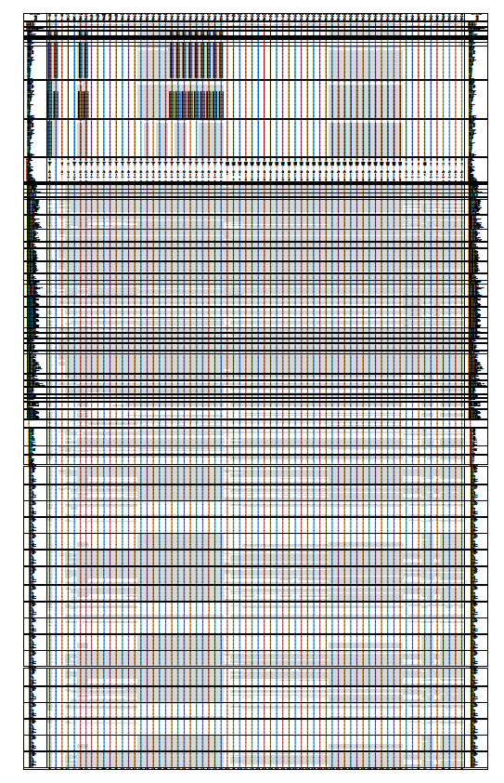
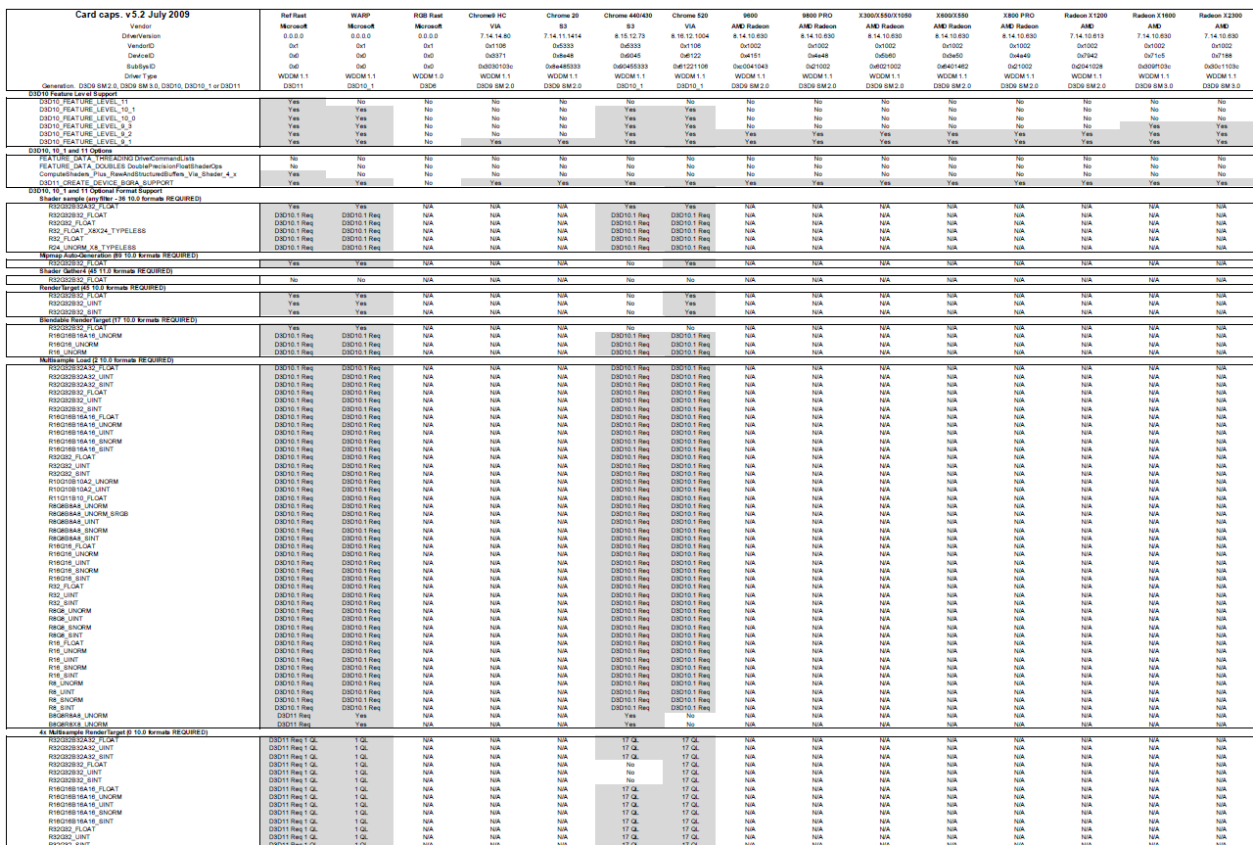
Notes:
DirectX SDK “Graphics Card Capabilities” article (located in the Samples\C++\Direct3D9\ConfigSystem folder)
Special thanks to AndyG!

Slide 8







DirectX 11 Feature Levels
Feature Level | Capabilities
D3D_FEATURE_LEVEL_10_0 (e.g. NVIDIA GeForce 8000/9000 Series; GTX 260/280) | Direct3D 10 hardware: Shader Model 4.0, geometry shader, stream out, alpha-to-coverage, MSAA textures, 2-sided stencil, general render target views, texture arrays, BC4/BC5, optional DirectCompute (CS 4.0), all 9_3 features.
D3D_FEATURE_LEVEL_10_1 (e.g. ATI Radeon HD 2000/3000/4000 Series; NVIDIA GeForce G210/GT220) | Direct3D 10.1 hardware: Shader Model 4.1, cubemap arrays, extended MSAA, optional DirectCompute (CS 4.1), all 10_0 features.
D3D_FEATURE_LEVEL_11_0 (e.g. ATI Radeon HD 5000 Series) | Direct3D 11 hardware: Shader Model 5.0, hull & domain shaders, mandatory DirectCompute (CS 5.0), BC6H/BC7, all 10_1 features.
Notes:
http://msdn.microsoft.com/en-us/library/ee422086.aspx
Note that the example cards show the ‘maximum’ feature level of the part (i.e. the ATI Radeon HD 2000 / 3000 / 4000 / 5000 Series also support D3D_FEATURE_LEVEL_10_0).

Slide 9
10level9 Feature Levels
Feature Level | Capabilities
D3D_FEATURE_LEVEL_9_1 (e.g. Intel G965 Express Chipset, NVidia GeForce FX 5200) | Direct3D 9 hardware: must support Shader Model 2.0 (vs_2_0/ps_2_0), 2K textures, volume textures, event queries, BC1-3 (aka DXTn), and a few other specific capabilities.
D3D_FEATURE_LEVEL_9_2 (e.g. ATI Radeon 9500) | Direct3D 9 hardware: must support Shader Model 2.0 (vs_2_0/ps_2_0), occlusion queries, float formats (no blending), extended caps, all 9_1 features.
D3D_FEATURE_LEVEL_9_3 (e.g. NVidia GeForce 6600, ATI Radeon X1300) | Direct3D 9 hardware: must support Shader Model 2.0 (vs_2_0/ps_2_b) with instancing, 4K textures, multiple render targets (4 MRTs), floating-point blending, all 9_2 features.
Notes:
Technically a 10_0+ card might not support any 10level9 feature levels if it has no Direct3D 9 support. Almost all Direct3D cards do, however, support all these features levels if they support D3D_FEATURE_LEVEL_10_0 or later. The one current special case is the Intel Integrated Graphics DX10 parts only support D3D_FEATURE_LEVEL_10_0 and D3D_FEATURE_LEVEL_9_1, but not 9_2 or 9_3

Slide 10
Driver Optional Features
Devices can expose some new DXGI_FORMATs
  ID3D11Device::CheckFormatSupport
BGRA (B8G8R8*8) formats
    required for 9_1, 9_2, 9_3 and 11_0
    optional for 10_0 / 10_1
10:10:10:2 X2 biased High Color mode (R10G10B10_XR_BIAS_X2_A2_UNORM)
    required for 11_0
    optional for 10_0 / 10_1
    not available for 9_1, 9_2, or 9_3
Majority of format support is defined by feature level
  Detailed in the DXGI Programmer’s Guide in the Windows Graphics documentation
Notes:
10_0: http://msdn.microsoft.com/en-us/library/ee415674.aspx
10_1: http://msdn.microsoft.com/en-us/library/ee415676.aspx
11_0: http://msdn.microsoft.com/en-us/library/ee416140.aspx
10level9: http://msdn.microsoft.com/en-us/library/ee416138.aspx

Slide 11
Driver Optional Features
DirectX 11 drivers can support four optional features
  ID3D11Device::CheckFeatureSupport
DirectCompute
  D3D_FEATURE_LEVEL_10_0 / 10_1 support for CS 4.x is optional
    CS 5.0 is required for D3D_FEATURE_LEVEL_11_0
Double-precision shader support is optional
Multithreading Driver support is optional
  Concurrent object creation
  Command lists
Notes:
http://msdn.microsoft.com/en-us/library/ee422109.aspx

Slide 12

Related Technologies
DirectX Graphics Infrastructure (DXGI) 1.1
  Version 1.0 introduced in Windows Vista
  Enumerates adapters, display modes, and outputs (e.g. monitors)
  New DXGI_FORMATs and improved support for remote desktops
Windows Display Driver Model (WDDM) 1.1
  WDDM 1.0 introduced in Windows Vista
  Unified driver model for all Direct3D APIs
Windows Advanced Rasterization Platform (WARP) 10
  Software rasterization device supporting 10.1 device functionality
  No ‘driver optional feature’ support
  Much faster than the DirectX SDK’s Reference device
Notes:
Graphics APIs in Windows
http://msdn.microsoft.com/en-us/library/ee417756.aspx
Windows Advanced Rasterization Platform (WARP) In-Depth Guide
http://msdn.microsoft.com/en-us/library/dd285359.aspx

Slide 13
Demo
Updated DxCapsViewer Utility

Slide 14
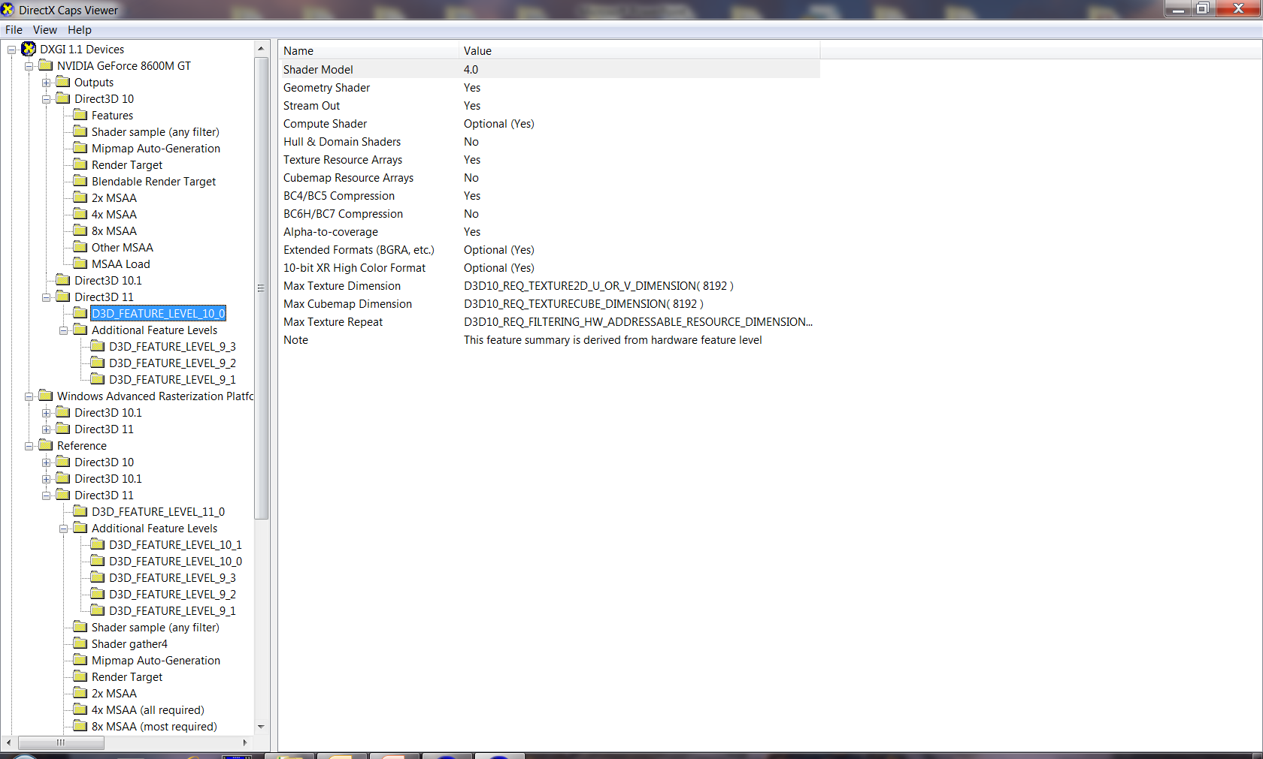
Notes:
Reference = This is the compliance software device installed by the DirectX SDK.

Slide 15
Direct3D 10.0 API
ID3D10Device
ID3D10DeviceChild
ID3D10Asynchronous
ID3D10Resource
ID3D10View
ID3D10VertexShader
ID3D10Query
ID3D10Buffer
ID3D10ShaderResourceView
ID3D10GeometryShader
ID3D10PixelShader
ID3D10Texture1D
ID3D10InputLayout
ID3D10Predicate
ID3D10RenderTargetView
ID3D10DepthStencilState
ID3D10Texture2D
ID3D10BlendState
ID3D10Counter
ID3D10DepthStencilView
ID3D10RasterizerState
ID3D10Texture3D
ID3D10SamplerState
Notes:
ID3D10Predicate technically derives from ID3D10Query
ID3D10Asynchronous, ID3D10Resource, and ID3D10View all derive from ID3D10DeviceChild

Slide 16
Direct3D 10.1 API
ID3D10Device1
ID3D10DeviceChild
ID3D10Asynchronous
ID3D10Resource
ID3D10View
ID3D10VertexShader
ID3D10Query
ID3D10Buffer
ID3D10ShaderResourceView1
ID3D10GeometryShader
ID3D10PixelShader
ID3D10Texture1D
ID3D10InputLayout
ID3D10Predicate
ID3D10RenderTargetView
ID3D10DepthStencilState
ID3D10Texture2D
ID3D10BlendState1
ID3D10Counter
ID3D10DepthStencilView
ID3D10RasterizerState
ID3D10Texture3D
ID3D10SamplerState
Notes:
Direct3D 10.1 still supports ID3D10BlendState and ID3D10ShaderResourceView as well

Slide 17
Direct3D 11 API (partial)
ID3D11Device
ID3D11DeviceChild
ID3D11Asynchronous
ID3D11Resource
ID3D11View
ID3D11VertexShader
ID3D11Query
ID3D11Buffer
ID3D11ShaderResourceView
ID3D11GeometryShader
ID3D11PixelShader
ID3D11Texture1D
ID3D11InputLayout
ID3D11Predicate
ID3D11RenderTargetView
ID3D11DepthStencilState
ID3D11Texture2D
ID3D11BlendState
ID3D11Counter
ID3D11DepthStencilView
ID3D11RasterizerState
ID3D11Texture3D
ID3D11SamplerState

Slide 18
ID3D11Device
ID3D11DeviceChild
ID3D11Asynchronous
ID3D11Resource
ID3D11View
ID3D11VertexShader
ID3D11Query
ID3D11Buffer
ID3D11ShaderResourceView
ID3D11GeometryShader
ID3D11PixelShader
ID3D11ComputeShader
ID3D11DomainShader
ID3D11Texture1D
ID3D11RenderTargetView
ID3D11HullShader
ID3D11Predicate
ID3D11DeviceContext
ID3D11InputLayout
ID3D11DepthStencilState
ID3D11Texture2D
ID3D11DepthStencilView
ID3D11BlendState
ID3D11RasterizerState
ID3D11SamplerState
ID3D11Counter
ID3D11ClassInstance
ID3D11Texture3D
ID3D11UnorderedAccessView
ID3D11ClassLinkage
ID3D11CommandList
Notes:
ID3D11Query derives from ID3D11Asynchronous
ID3D11DeviceContext, ID3D11Asynchronous, ID3D11Resource, and ID3D11View derive from ID3D11DeviceChild

Slide 19
Direct3D 11 API Change
Main difference is ID3D10Device was split in two
  Object creation in ID3D11Device interface
  Other methods split off into ID3D11DeviceContext interface
    Rendering and state configuration
    Map()/Unmap() from resource objects
    Begin(), End(), and GetData() from query objects
    One immediate context for rendering directly to the device
    Zero or more deferred contexts for creating command lists
Provides basis of multithreading improvements

Slide 20
Multi-threading Rules
ID3D11Device is thread-safe
  Without driver support for Concurrent Creates, runtime will enforce thread-safety with a coarse lock
  Without driver support for Concurrent Creates, creating objects and rendering with the immediate context will not be concurrent (using the same coarse lock)
  Methods on most other objects (ID3D11DeviceChild-derived) are also thread-safe
  Can opt-out by using D3D11_CREATE_DEVICE_SINGLETHREADED

Slide 21
Multi-threading Rules
ID3D11DeviceContext is not thread-safe
  Typical usage is one device context per thread, one of them using immediate and the rest using deferred contexts
  Note that DXGI methods should not be used concurrently while rendering with the immediate device context
    For example, Present() uses the immediate device context
  It is thread-safe to use the methods inherited from ID3D11DeviceChild
    AddRef(), Release(), QueryInterface()
    GetDevice(), GetPrivateData(), SetPrivateData(), SetPrivateDataInterface()

Slide 22
Multi-threading Rules
ID3D11DeviceContext deferred mode limitations
  Map() must be used with D3D11_MAP_WRITE_DISCARD and/or D3D11_MAP_WRITE_NO_OVERWRITE
  GetData() for queries is not allowed
  Queries can be used in conjunction with predication
  If executing a deferred command list with a query active
    and the command list itself uses the same query,
    then the command list submission is ignored as invalid

Slide 23
Multi-threading Recommendations
Concurrent creation is a no brainer
  Many engines already have resource loading threads
  Runtime emulation is “good enough” for a win
    Less overhead than the default Direct3D 10 M/T behavior
  ConcurrentCreates driver support makes it better
  When creating objects with M/T driver support, providing initial data for static objects should be more efficient
    i.e Use the pInitialData parameter on the Create rather than staging resources, UpdateSubResource(), or Map() when possible

Slide 24
Multi-threading Recommendations
Concurrent submission depends on the scenario
  Useful for Triple-core, Quad-core, or more
    For Dual-core, it is less likely to be worthwhile
  Best use scenario is one rendering thread per core
    Ideally use the Windows Vista/Windows 7 thread pool API
    If you roll your own solution, see the DirectX SDK CoreDetection sample for the robust way to determine number of cores
  Similar but not identical to Xbox 360 Command Buffers
  Driver CommandLists support is currently rare
Notes:
Known Issue in DX11 RTM: Deferred Context UpdateSubResource with the runtime non-driver implementation will fail to handle a non 0,0,0 offset correctly.
Thread Pool API: http://msdn.microsoft.com/en-us/library/ms686766.aspx
CoreDetection shows best practices for computing thread affinity masks including taking the process mask and hyperthreading into account. In general use the GetLogicalProcessorInformation() API when it’s available (Windows XP Service Pack 3, Windows Vista, Windows 7, Windows Server 2008, Windows Server 2008 R2). It is available on Windows Server 2003 SP1+ (which includes Windows XP Professional x64 Edition) but it should be avoided as it has some known bugs with respect to hyper-threading (http://support.microsoft.com/kb/932370). Otherwise you have to use CPUID with vendor-specific extensions.

Slide 25
Porting to Direct3D 11 from 10.x
Start with a simple text translation
  ID3D10* -> ID3D11*
  D3D10_* -> D3D11_*
If starting with Direct3D 10.0, will need to fix up a few minor structure differences
    (11 matches the 10.1 version)
  D3D10_BLEND_DESC1
  D3D10_SHADER_RESOURCE_VIEW_DESC1
Notes:
See “Migrating to Direct3D 11” http://msdn.microsoft.com/en-us/library/ee416254.aspx

Slide 26
Porting to Direct3D 11 from 10.x
Change rendering & state calls from device to immediate context
    After getting port done, will want to revisit this
Change resource Map() and query Begin(), End(), & GetData() to use immediate context
Create*Shader takes an additional class linkage parameter (can use NULL)
*SetShader and *GetShader take an additional class instance parameter (can use NULL)
Notes:
See “Migrating to Direct3D 11” http://msdn.microsoft.com/en-us/library/ee416254.aspx

Slide 27
Porting to Direct3D 11 from 10.x
Some defines changed, so be sure you aren’t using magic numbers (D3D10_RESOURCE_MISC_FLAG)
A minor feature was completely dropped
  ID3D10Device::GetTextFilterSize
  ID3D10Device::SetTextFilterSize
  D3D10_FILTER_TEXT_1BIT
Vendor-neutral performance counters removed
  Were rarely implemented or consistent
  i.e. D3D11_COUNTER_DEVICE_DEPENDENT_0 is the only counter enumeration
Notes:
See “Migrating to Direct3D 11” http://msdn.microsoft.com/en-us/library/ee416254.aspx

Slide 28
Porting to Direct3D 11 from 9
Essentially the same as porting from Direct3D 9 to Direct3D 10.x
  Remove all fixed-function pipeline usage
  Use state management based on immutable state objects
  Obey strict shader linkage and input layout rules
  Use shader resource views associated with texture resources
  Map data to DXGI_FORMATs (no 16-bit formats, no 24-bit color format, strict RGB color order)
  Rework global constant data into several constant buffers for efficient update
Notes:
See “Migrating to Direct3D 11” http://msdn.microsoft.com/en-us/library/ee416254.aspx

Slide 29
Porting to Direct3D 11 from 9
Start with the existing guidance for moving from Direct3D 9 to Direct3D 10
  SIGGRAPH 2007 Course #5
    Introduction to Direct3D 10
    http://msdn.microsoft.com/directx/presentations
  Gamefest 2007 talk
    “Windows to Reality: Getting the Most out of Direct3D 10 Graphics in Your Games”
    http://www.microsoftgamefest.com/presentations/2007.htm
Notes:
See “Direct3D 9 to Direct3D 10 Considerations” http://msdn.microsoft.com/en-us/library/ee415668.aspx

Slide 30
HLSL Compiler
DirectX 11 requires 4.0 or later profile shaders
D3DCompile DLL contains latest HLSL compiler
  Used by D3DX9, D3DX10, D3DX11, and FXC.EXE
  Can use directly (i.e. without using D3DX)
    Note it is in its own DirectSetup CAB file in the REDIST folder
  Supports all shader models except Pixel Shader 1.x profiles
Vertex | Pixel | Geometry | Compute | Hull | Domain
vs_4_0 | ps_4_0 | gs_4_0 | cs_4_0
vs_4_1 | ps_4_1 | gs_4_1 | cs_4_1
vs_5_0 | ps_5_0 | gs_5_0 | cs_5_0 | hs_5_0 | ds_5_0
vs_4_0_level_9_1 | ps_4_0_level_9_1
vs_4_0_level_9_3 | ps_4_0_level_9_3
Notes:
There is a version of the HLSL compiler built into the OS through D3D10Compile*, but it well out of date and only supports 4.0 shader models.
Note there is no vs/ps_4_0_level_9_2. Use vs/ps_4_0_level_9_1 for both 9.1 and 9.2 feature levels
Not listing the D3D9 profiles here, but they are also all supported by the current HLSL compiler except ps_1_1, ps_1_2, ps_1_3, and ps_1_4.

Slide 31
Shader Profiles and Feature Levels
Shader profiles in DirectX 11 can be applied to higher feature levels, but not lower
10level9 shader profiles are compiled twice internally
  vs_4_0_level_9_* => vs_2_0 + vs_4_0
  ps_4_0_level_9_1 => ps_2_0 + ps_4_0
  ps_4_0_level_9_3 => ps_2_b + ps_4_0
Shader Profile vs. Device Feature Level | 11_0 | 10_1 | 10_0 | 9_3 | 9_2 | 9_1
5_0 | Yes | - | - | - | - | -
4_1 | Yes | Yes | - | - | - | -
4_0 | Yes | Yes | Yes | - | - | -
4_0_level_9_3 | Yes | Yes | Yes | Yes | - | -
4_0_level_9_1 | Yes | Yes | Yes | Yes | Yes | Yes
Notes:
Note this is also true of Direct3D 10.1

Slide 32
HLSL Recommendations
Use the latest compiler
  Esp. avoid the ‘in box’ D3D10Compile APIs
Generally use the lowest profile possible for VS/PS when supporting 10level9
For DirectCompute
  prefer CS 5.0 over CS 4.x
  Prefer CS 4.1 over CS 4.0
Compile your shaders offline for your retail game

Slide 33
Effects (FX) Library
Effects for Direct3D 11 (FX11) is shared source in DX SDK
  FX9 was in D3DX9
  FX10 was in box with the OS
Porting from FX10 -> FX11 is fairly trivial
  Essentially the same API without effects pools
Porting from FX9 -> FX11 requires significant code change
 | HLSL Profile
Effects 9 | fx_2_0
Effects 10 | fx_4_0 and fx_4_1
Effects 11 | fx_5_0

Slide 34
D3DX11
Includes texture loaders (BMP, JPG, PNG, DDS, TIFF, GIF)
  and asynchronous loaders introduced with D3DX10
Does not include D3DX Math, Mesh, Sprite, or Font
  See XNAMath as alternative for D3DX Math
  and DXUT11 for alternative to font, etc.
D3DX11 uses a CPU codec for BC6H/BC7 texture compression, which can be time-consuming.
For a fast DirectCompute 4.x solution, see the BC6HBC7EncoderDecoder11 sample.

Slide 35
D3DCSX
Optional extended D3DX DLL for Compute Shader
  Resides in its own DirectSetup / REDIST CAB
DirectCompute (CS 5.0) utility functions
  ID3DX11Scan
    Unsegmented Scan or Multiscan
    Segmented Scan
  ID3DX11FFT
    1D, 2D, 3D support
    Real or Complex
    Forward or Inverse Transform with optional scale
Notes:
Expecting CS 4.x support for FFT in Feb2010

Slide 36
XNAMath
aka xboxmath 2.0
Inline C++ SSE/SSE2 optimized math library
  VMX128 optimized on Xbox
~350 functions
  Focused on single-precision floating-point operations
  Limited integer operations
  Conversion to/from packed graphics formats
  Implemented using Visual Studio intrinsics
  Supports x86 and x64 native
Common 3D primitives
  Vectors, matrices, planes, quaternions, etc.

Slide 37
DirectX 11 Deployment
DirectX 11 Runtime is included with Windows 7 and Windows Server 2008 R2
DirectX 11 Runtime can be deployed down-level to Windows Vista / Server 2008
D3DX11, D3DCSX, D3DCompile, etc. installed by DirectSetup / DX SDK REDIST
  Just like D3DX9, D3DX10, XAUDIO2, etc.
The DirectX SDK does not install the DirectX 11 Runtime
  The DX SDK does install the debug layers and reference device

Slide 38
DirectX 11 Runtime
Direct3D 11
  New API supporting 10, 10.1, 11, 10level9, and WARP10
DXGI 1.1
  D3D glue library updated for new formats and WDDM 1.1 driver features
WARP10
  10.1 level software renderer
10level9
  Direct3D 9 Shader Model 2.0 h/w support (9_1, 9_2, 9_3 feature levels)
Direct3D 10.1
  Updated existing API to support WARP10, 10level9
Direct2D
  GDI-like 2D drawing API for working on Direct3D surfaces
DirectWrite
  High-quality, feature-rich font rendering API (works with Direct2D)

Slide 39
KB 971644
Platform Update for Windows Vista
  http://go.microsoft.com/fwlink/?LinkId=160189
Deployed through Windows Update
Requires Windows Vista / Server 2008 SP2 to be installed
See the D3D11InstallHelper sample in the DirectX SDK for detection, applying the KB, and messaging for RTM / SP1
Detailed in Direct3D 11 Deployment for Game Developers technical article
Notes:
Will likely be included in a future Service Pack 3 for Windows Vista / Server 2008
http://msdn.microsoft.com/en-us/library/ee416644.aspx

Slide 40
KB 971512
For corporate network environments using Windows Server Update Servers (WSUS), KB 971644 is not available
Use this update instead
  Windows Graphics, Imaging, and XPS Library
    http://support.microsoft.com/kb/971512/
Local IT admin will need to approve the update through the managed WSUS servers
Requires Windows Vista / Server 2008 SP2 to be installed

Slide 41
Recommendations
Update your existing Direct3D 10.x code path to use Direct3D 11
  This requires some installer/deployment work
  Your DX11 code path will require Windows Vista SP2+ or Windows 7
For Windows Vista / Windows 7 titles
  10level9 feature levels can provide more hardware support, so you don’t need a Direct3D9 code path
For titles that need Windows XP support,
  you will need a legacy Direct3D9 code path
Notes:
Gamefest talk link on KB940105: <http://download.microsoft.com/download/e/3/c/e3c25fea-2b53-4174-8729-29a4ec16583b/Why%20Your%20Windows%20Game%20Won't%20Run%20In%202,147,352,576%20Bytes.zip>

Slide 42
Recommendations
If you still only have a legacy Direct3D 9 code path
  Now’s the time to invest in DirectX 11
  Take advantage of the existing resources
  Lessons learned moving from D3D9 -> D3D10 all apply to moving from D3D9 -> D3D11
Direct3D 11 provides
  the latest hardware features
  new features for existing 10.x hardware
  and supports the majority of video cards with WDDM drivers

Slide 43
Resources
Latest DirectX SDK
  http://msdn.microsoft.com/directx
Gamefest 2008 Graphics and Partners Tracks
  http://www.microsoftgamefest.com/presentations/2008.htm
Gamefest 2010 Graphics Track
  “Think DirectX11 Tessellation! – what are your options?”
  “DirectX 11 DirectCompute – A Teraflop for Everyone”
  “Block Compression Smorgasbord”
  and additional talks from AMD & NVIDIA

Slide 44
APPENDIX

Slide 45
#include “d3d10.h”
IDXGISwapChain *g_pSwapChain = NULL;
ID3D10Device *g_pDevice = NULL;
…
DXGI_SWAP_CHAIN_DESC sd;
// Set to desired values
…
HRESULT res = D3D10CreateDeviceAndSwapChain( NULL, D3D10_DRIVER_TYPE_HARDWARE,
NULL, 0, D3D10_SDK_VERSION, &sd,
&g_pSwapChain, &g_pDevice );
if ( FAILED(res) ) // Error Handling
// Bind render target from swap chain
// Set up viewport
…
Notes:
Creating a device & swap-chain on Direct3D 10

Slide 46
#include “d3d10_1.h”
IDXGISwapChain *g_pSwapChain = NULL;
ID3D10Device1 *g_pDevice = NULL;
…
DXGI_SWAP_CHAIN_DESC sd;
// Set to desired values
…
HRESULT res = D3D10CreateDeviceAndSwapChain1( NULL, D3D10_DRIVER_TYPE_HARDWARE,
NULL, 0, D3D10_FEATURE_LEVEL_10_1, D3D10_1_SDK_VERSION, &sd,
&g_pSwapChain, &g_pDevice );
if ( FAILED(res) )
{
res = D3D10CreateDeviceAndSwapChain1( NULL, D3D10_DRIVER_TYPE_HARDWARE,
NULL, 0, D3D10_FEATURE_LEVEL_10_0, D3D10_1_SDK_VERSION, &sd,
&g_pSwapChain, &g_pDevice );
}
if ( FAILED(res) ) // Error Handling
// Bind render target from swap chain
// Set up viewport
…
// use g_pDevice->GetFeatureLevel() to check for 10_1; can otherwise assume 10_0
Notes:
Creating a device & swap-chain with Direct3D 10.1 where you support both 10.1 and 10.0 features.
NOTE: With Direct3D 10.1 you can obtain a Direct3D 10 interface, which can be useful for gluing together code that uses Direct3D 10. This works with either 10_0 or the 10_1 feature level for DX10.
ID3D10Device *g_pDevice10 = NULL;
hr = g_pDevice->QueryInterface( __uuidof( ID3D10Device ), (LPVOID*)&m_pDevice10 );
Note only Windows Vista RTM & Windows Server 2008 RTM support Direct3D 10, but not Direct3D 10.1.
This sample doesn’t support the 9_1, 9_2, or 9_3 feature levels since those are only available in the same scenarios where Direct3D 11 is available.

Slide 47
#include “d3d11.h”
IDXGISwapChain *g_pSwapChain = NULL;
ID3D11Device *g_pDevice = NULL;
ID3D11DeviceContext* g_pContext = NULL;
…
DXGI_SWAP_CHAIN_DESC sd;
// Set to desired values
…
D3D_FEATURE_LEVEL flvl[] = {
D3D_FEATURE_LEVEL_11_0, D3D_FEATURE_LEVEL_10_1, D3D_FEATURE_LEVEL 10_0 };
D3D_FEATURE_LEVEL fl;
HRESULT res = D3D11CreateDeviceAndSwapChain( NULL, D3D_DRIVER_TYPE_HARDWARE,
NULL, 0, flvl, sizeof(flvl)/sizeof(D3D_FEATURE_LEVEL),
D3D11_SDK_VERSION, &sd,
&g_pSwapChain, &g_pDevice, &fl, &g_pContext );
if ( FAILED(res) ) // Error Handling
// Bind render target from swap chain
// Set up viewport
…
// use g_pDevice->GetFeatureLevel() (or remember fl above) to check for
// 11_0 or 10_1, assume 10_0 otherwise
Notes:
Creating a device & swap-chain with Direct3D 11 where you want an 11, 10.1, or 10.0 device. Note we get both a device and the immediate device context back

Slide 48
#include “d3d11.h”
IDXGISwapChain *g_pSwapChain = NULL;
ID3D11Device *g_pDevice = NULL;
ID3D11DeviceContext* g_pContext = NULL;
…
DXGI_SWAP_CHAIN_DESC sd;
// Set to desired values
…
D3D_FEATURE_LEVEL flvl[] = {
D3D_FEATURE_LEVEL_11_0, D3D_FEATURE_LEVEL_10_1, D3D_FEATURE_LEVEL 10_0,
D3D_FEATURE_LEVEL_9_3, D3D_FEATURE_LEVEL_9_2, D3D_FEATURE_LEVEL_9_1 };
D3D_FEATURE_LEVEL fl;
HRESULT res = D3D11CreateDeviceAndSwapChain( NULL, D3D_DRIVER_TYPE_HARDWARE,
NULL, 0, flvl, sizeof(flvl)/sizeof(D3D_FEATURE_LEVEL),
D3D11_SDK_VERSION, &sd,
&g_pSwapChain, &g_pDevice, &fl, &g_pContext );
if ( FAILED(res) ) // Error Handling
// Bind render target from swap chain
// Set up viewport
…
// use g_pDevice->GetFeatureLevel() (or remember fl above) to check feature level
Notes:
Creating a device & swap-chain with Direct3D 11 where you want any supported device.
NOTE: If you really only care about a single feature-level, you can just specify one feature level and always use it.

Slide 49
#include “d3d11.h”
IDXGISwapChain *g_pSwapChain = NULL;
ID3D11Device *g_pDevice = NULL;
ID3D11DeviceContext* g_pContext = NULL;
…
DXGI_SWAP_CHAIN_DESC sd;
// Set to desired values
…
HRESULT res = D3D11CreateDeviceAndSwapChain( NULL, D3D_DRIVER_TYPE_HARDWARE,
NULL, 0, NULL, 0,
D3D11_SDK_VERSION, &sd,
&g_pSwapChain, &g_pDevice, NULL, &g_pContext );
if ( FAILED(res) ) // Error Handling
// Bind render target from swap chain
// Set up viewport
…
// use g_pDevice->GetFeatureLevel() to check feature level
Notes:
NULL feature level array is equivalent to asking for any feature level. The created feature level is also an optional parameter.

Slide 50
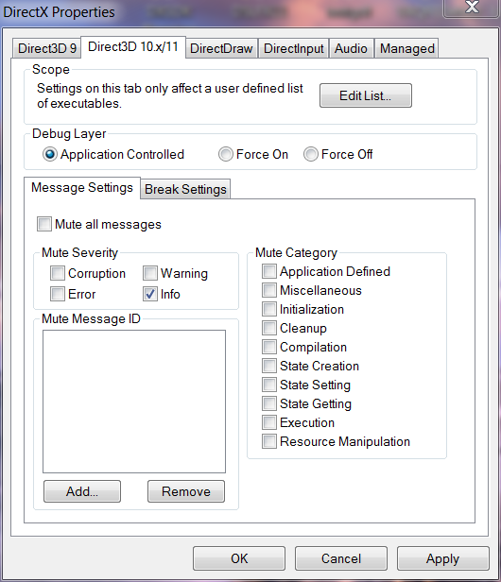
DirectX 11 Debugging
DirectX SDK provides debugging layer
Enabled through code (D3D11_CREATE_DEVICE_DEBUG) or the DirectX Control Panel utility
  Control panel controls the 10 and 11 debugging layer through the same settings
  Unlike Direct3D 9, it is per application not a global setting
Prints messages to Windows debug output

Slide 51
DirectX 11 Debugging
Make sure your application runs ‘debug layer’ clean
  ERROR and CORRUPTION reports are critical to fix
  Tools like PIX for Windows assume this level of correctness
Can also make use of the ID3D11Debug and D3D11InfoQueue interfaces
  Obtain via QueryInterface from Direct3D 11 Device
  Exists only if debug layer is attached
  ID3D10Debug::Validate() split into ValidateContext() and ValidateContextForDispatch()
  New method for DX11 Debug Layer
    ID3D11Debug::ReportLiveDeviceObjects()

Slide 52
Debug Resource Naming
Debug layer messages in debug window use ‘friendly names’ for resources, defaults to “unnamed”
Can set the name by using the SetPrivateData() API in combination with a ‘well-known’ GUID from d3dcommon.h
#ifndef NDEBUG
// Only works if device is created with the D3D10 or D3D11 debug layer
const char c_szName[] = "texture.jpg";
pObject->SetPrivateData( WKPDID_D3DDebugObjectName,
sizeof( c_szName ) - 1, c_szName );
#endif
Notes:
This works on both the Direct3D 10.x or Direct3D 11 debug layer

Slide 53
Windows 7 / Server 2008 R2 only
A few DirectX-branded technology pieces are not available down-level
  Direct3D9Ex video HD and overlay extensions
  Direct3D9Ex D3DSWAPEFFECT_FLIPEX and improved frame statistics
  DirectMusic ‘core’ API for x64 native (time stamped MIDI, software synthesizer)
Windows Media Foundation improvements are not also included
Notes:
WMF in Windows 7
http://msdn.microsoft.com/en-us/library/bb970511(VS.85).aspx

